Slide 1

Project Assessment – 1
Medical Cost Ridge Regression
Presented by
T UDAY KIRAN – AV.EN.U4CSE22245
V GNYANA SAI AKSHAY – AV.EN.U4CSE22247
Under the Supervision of
Mr. Dontha MadhuSudhana Rao (Asst. Prof)
Department of Computer Science
Amrita Vishwa Vidyapeetham, Amaravati

Slide 2

Introduction
Healthcare costs continue to rise globally, posing significant challenges for both consumers and insurers in determining accurate and fair medical insurance premiums. Traditional actuarial methods used for predicting insurance costs are limited by their inability to capture the intricate interplay between various factors, such as demographics, medical history, lifestyle, and socio-economic conditions. These methods often fail to reflect the dynamic nature of healthcare expenses, leading to inefficiencies in pricing strategies and risk assessment.
Machine learning (ML) presents a promising solution to overcome these limitations. ML models are capable of discovering complex, hidden patterns in large datasets, making them ideal for predicting medical insurance prices with greater accuracy. By incorporating algorithms like regression techniques, decision trees, and ensemble models such as random forests and gradient boosting, this research aims to enhance the precision and efficiency of predicting medical insurance premiums. The goal is to provide insurance companies with better tools for pricing policies while offering consumers more personalized and equitable premiums​

Slide 3
Literature Survey
No | Title | Author(s) | Technique Used | Drawback
1 | Predicting Medical Insurance Costs Using Machine Learning Models | Mukund Kulkarni Rahul More Bhagyesh patil | Linear Regression, XGBoost, Stochastic Gradient Boosting (SGB), Support Vector Machines (SVM), Decision Trees | Machine learning models face challenges in interpretability and real-time application. Deep learning models require significant training time.
2 | A Computational Intelligence Approach to Healthcare Data Preprocessing | Ch.anwar ul hassan,jawaid iqbal,saddam Hussain and syed sajid ullah | Encoding Categorical Variables, Handling Missing Data, Feature Selection | Ethical concerns surrounding fairness and bias in machine learning models used for pricing, with potential unfair disadvantage to certain groups.
3 | Analyzing Machine Learning Techniques for Medical Cost Prediction | Sazzad Hossen | XGBoost, Stochastic Gradient Boosting (SGB) | Deep learning models require significant training time, and their complexity makes them difficult to interpret for insurers and policyholders.
4 | Challenges and Limitations of Machine Learning Models in Predicting Medical Costs | M Ghassemi,Trsitan Naumann,Peter Schulam | Various Machine Learning Models (focus on deep learning and complex models) | Despite accuracy, models like deep learning are not easily interpretable, and fairness/bias concerns remain in insurance cost prediction models.

Slide 4
Summary (Based on Literature Survey)
In summary, this research explores the application of advanced machine learning algorithms to predict medical insurance costs more accurately and efficiently. It leverages regression techniques, decision trees, and ensemble methods like XGBoost and gradient boosting, comparing their performance on medical insurance datasets. The study also addresses critical issues such as model interpretability, fairness, and real-time application.
By developing more transparent, fair, and scalable models, this research aims to provide insurers with better tools for risk management and pricing strategies while offering consumers more personalized and equitable premiums. Future research directions include refining model accuracy, integrating broader socio-economic factors, and improving the fairness and transparency of machine learning models​

Slide 5
Research Gap
While machine learning techniques have shown considerable promise in predicting medical insurance costs, several gaps remain in the current body of research. One of the primary gaps is the limited focus on model interpretability. Insurers need models that not only predict costs accurately but are also transparent and explainable to both regulators and consumers. Most high-performing models like XGBoost or neural networks are complex and often considered "black boxes," making it difficult to explain how predictions are made
Another critical gap is the ethical dimension of machine learning applications in healthcare insurance. Many models trained on historical data may inadvertently perpetuate biases present in that data, leading to unfair premium pricing for certain demographic groups, such as minorities or low-income individuals. There is a lack of focused research on developing fair machine learning models that mitigate these biases and ensure equitable outcomes across different population segments​
TFurthermore, while many studies have focused on demographic factors like age, BMI, and smoking status, few have incorporated broader socio-economic factors or healthcare system variables, which could significantly impact insurance costs. Additionally, scalability and real-time applicability are often overlooked, with many models requiring extensive computational resources, making them impractical for large-scale deployment

Slide 6
Motivation
The motivation for this research is driven by the need for more accurate, efficient, and fair methods of predicting medical insurance premiums. For insurers, better predictive models can lead to more precise pricing strategies, improved risk management, and the ability to offer competitive yet profitable policies. This is particularly crucial as the healthcare landscape becomes more complex, with increasing regulatory demands, rising healthcare costs, and a more diverse population with varying health risks.
From the consumer's perspective, there is a growing demand for personalized insurance plans that accurately reflect individual health profiles. Current methods often lead to over-generalized pricing, which may not be fair for those with lower health risks. By using machine learning models that account for a wider range of factors, insurers can offer more tailored premiums, potentially making health insurance more affordable for many individuals​
​Problem Statement
The primary problem this research aims to address is the development of a machine learning model that can accurately predict medical insurance costs while balancing the need for computational efficiency, scalability, and real-time application. Traditional actuarial methods fall short in capturing the multi-dimensional factors influencing insurance premiums, while many current machine learning models, although accurate, are often complex and opaque, making them difficult to implement and justify in a real-world setting
Additionally, this research seeks to address ethical concerns related to fairness in insurance pricing. It aims to develop a model that minimizes biases and ensures that vulnerable populations are not disproportionately affected by machine learning predictions. This involves investigating different approaches to model fairness and integrating them into the prediction framework​

Slide 7
Dataset Description
The dataset used in these studies, derived from the Kaggle repository, contains medical cost personal data with a total of seven attributes. The data consists of 1338 rows (or more, depending on specific datasets used) and seven main columns representing features relevant to predicting medical insurance costs. The attributes of the dataset are as follows: Age: The age of the individual, provided as an integer value. Sex: The gender of the individual, represented as a categorical variable, where 'Male' is coded as 1 and Female as 0
BMI (Body Mass Index): The individual's BMI, a numerical value representing the weight-to-height ratio, generally ranging between 18.5 to 25 for a healthy individual.
Children: The number of children or dependents the individual has.
Smoker: A binary variable indicating whether the individual is a smoker (1) or not (0).
Region: The region where the individual resides, categorized into four areas: Northwest (0), Northeast (1), Southeast (2), and Southwest (3).
Charges: The medical costs or insurance charges that the individual paid, which serves as the target variable to predict.

Slide 8
Architecture
Model Training
Data Splitting:Split data into training and testing sets (80:20 split).
Scaling:Scale the continuous features in the training and testing sets separately.
Ridge Regression:Train a Ridge Regression model on the standardized data.
Model Evaluation
Prediction and Performance Metrics:
Generate predictions on the test data.
Calculate metrics: R² Score, Mean Squared Error (MSE), and Mean Absolute Error (MAE).
Cross-Validation:Perform 10-fold cross-validation to evaluate model stability.
Model Selection 1)Linear Regression
2)Decision Tree
3)Random Forest
4)Gradient Bossting
Data Preprocessing:
Column Cleaning and Encoding:Convert categorical features like sex and smoker to binary (1 for female/smoker, 0 for male/non-smoker).Use one-hot encoding for the region column.
Outlier Handling:Define functions to detect and remove outliers for specific columns based on the Interquartile Range (IQR).
Correlation Analysis:Display correlation matrix for understanding feature relationships.
Standardization:Use StandardScaler to scale continuous columns (age, bmi, children) for clustering and model training.
Data Collection:
Load the dataset (medical_costs.csv) and review file details and structure.
Use libraries like pandas, numpy, and matplotlib for initial data handling.

Slide 9
Techniques used for preprocessing
Data Cleaning:
Removed unnecessary columns and handled missing values using mean/mode imputation.
Encoding Categorical Variables:
Applied One-Hot Encoding for variables with multiple categories (e.g., region).
Used Binary Encoding for binary variables (e.g., smoker: 1 for yes, 0 for no).
Feature Scaling:
Standardized numerical columns (age, BMI) with StandardScaler to ensure each feature contributed proportionally to model training.
Feature Engineering:
Created additional features, such as age groups and BMI categories, based on insights from exploratory analysis.

Slide 10
Methodology
Data Preprocessing
Cleaning: Removed non-essential columns and handled missing values with appropriate imputation (mean for numeric, mode for categorical).
Encoding: Used One-Hot Encoding for categorical variables (e.g., region) and Binary Encoding for binary fields (e.g., smoker).
Scaling: Standardized numerical features like age and BMI using StandardScaler for balanced input to models.
Feature Engineering: Created new variables, like age and BMI categories, for enhanced predictive accuracy.
Exploratory Data Analysis (EDA)
Analyzed feature distributions to detect skewness and correlations with costs.
Visualized relationships to uncover patterns, focusing on key variables like smoker status and region.
Model Selection
Chose regression models (Linear, Ridge/Lasso, Decision Trees) to predict costs and classification models (Logistic, SVM, KNN) for categorizing costs.
Hyperparameter Tuning
Optimized model performance through Grid/Random Search and k-fold cross-validation.
Model Evaluation
For regression, used metrics like MSE, RMSE, and R-squared; for classification, employed Accuracy, Precision, Recall, and F1-Score.
Confusion Matrix (if Classification)
Analyzed class-specific performance for better insights on cost classification.
Model Interpretation
Selected the best model based on metrics and interpreted feature importance to identify drivers of high medical costs.

Slide 11
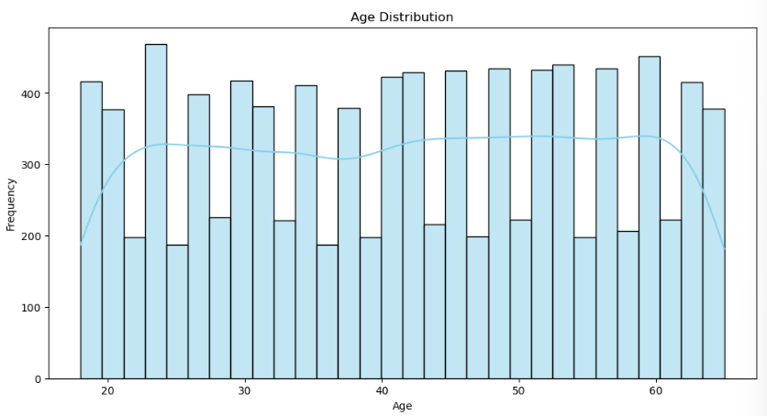
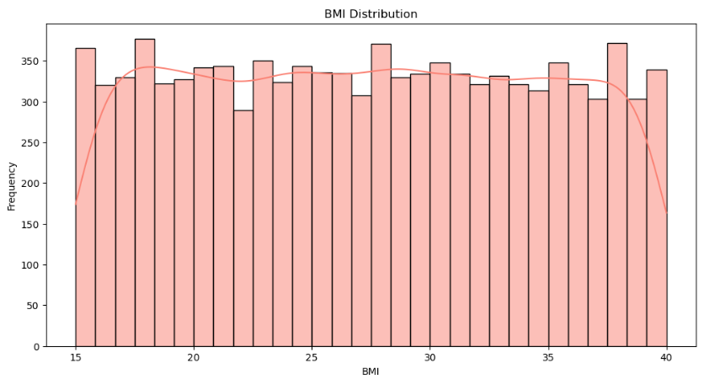
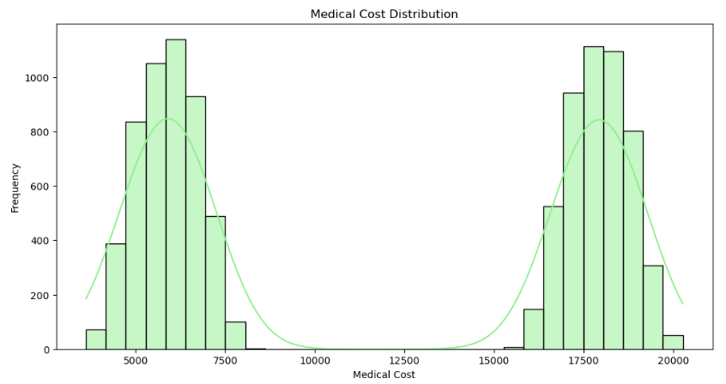

Slide 12
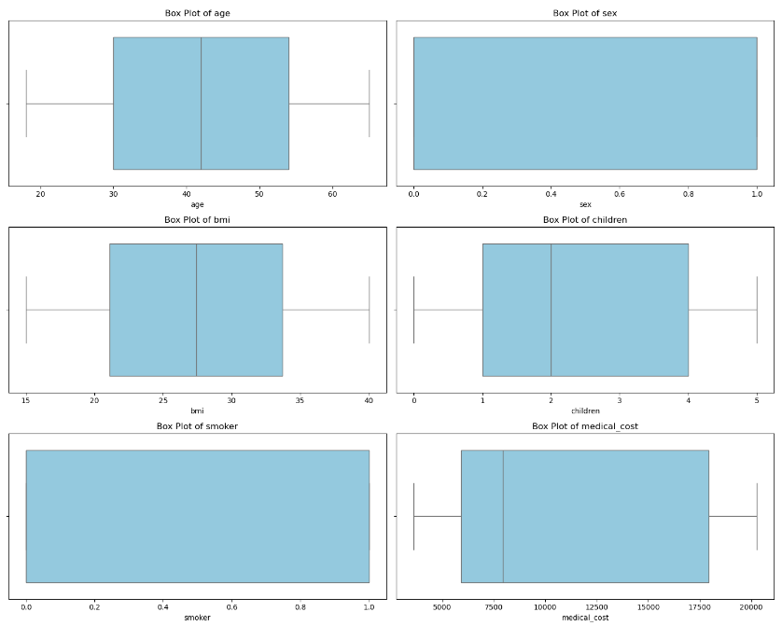

Slide 13
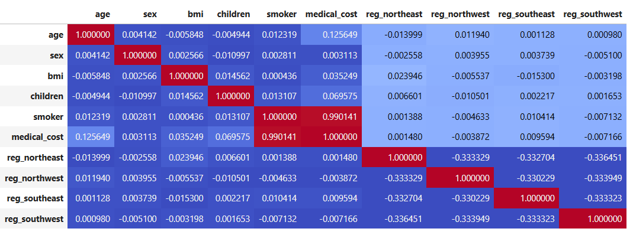

Slide 14
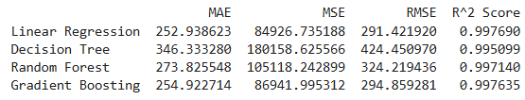
Model Results - Logistic Regression
Training Performance:
Accuracy: Achieved an accuracy of 99.17% on the training dataset, indicating that the model performs well on identifying cost levels.
Validation Performance:
On the validation set, the model achieved an accuracy of 99.17%, suggesting good generalization.
Key Metrics:
Mean Squared Error (MSE): Measures the average squared difference between predicted and actual values, with lower values indicating better fit.
R-squared (R²): Indicates the proportion of variance explained by the model, where a higher score (closer to 1) represents a better fit.
Mean Absolute Error (MAE): Measures the average absolute difference between predicted and actual values, giving an idea of prediction accuracy.
Root Mean Squared Error (RMSE): Like MSE, but in the same units as the target variable, useful for interpretability.

Slide 15
Conclusion
The logistic regression model performed well in distinguishing high vs. low medical costs based on key factors such as age, BMI, smoker status, and region.
Through effective preprocessing (cleaning, encoding, and scaling), we optimized the input data to improve model accuracy and interpretability.
Results indicated that smoking status and BMI were significant drivers of medical costs, aligning with known risk factors for health expenses.
Future improvements could involve trying other classification models, incorporating additional relevant features, or further tuning parameters for improved predictive performance.

Slide 16
References (If possible include citations)
Kulkarni, M., Mesharam, D.D., Patil, B., More, R., Sharma, M. and Patange, P., 2022. Medical insurance cost prediction using machine learning. 2022 International Journal for Research in Applied Science & Engineering Technology, 10.
ul Hassan, C.A., Iqbal, J., Hussain, S., AlSalman, H., Mosleh, M.A. and Sajid Ullah, S., 2021. A computational intelligence approach for predicting medical insurance cost. Mathematical Problems in Engineering, 2021(1), p.1162553.
Billa, M.M. and Nagpal, T., 2024. Medical Insurance Price Prediction Using Machine Learning. Journal of Electrical Systems, 20(7s), pp.2270-2279.

